Slide 1

Precision Medicine Centre Karolinska
Digital Futures Hub, KTH
2022-03-25

Slide 2
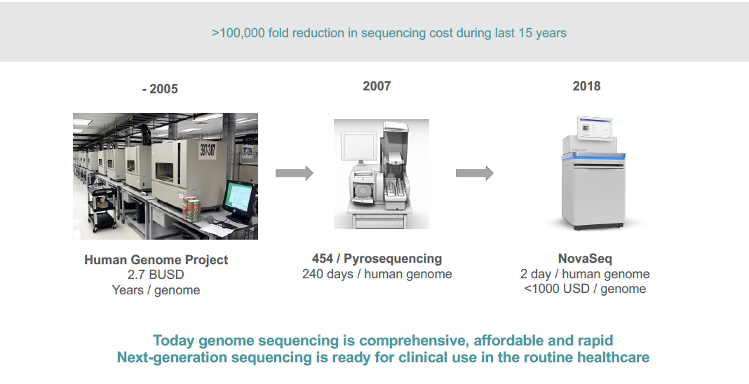
Precision medicine originates from the development of genomics over the last two decades

Slide 3
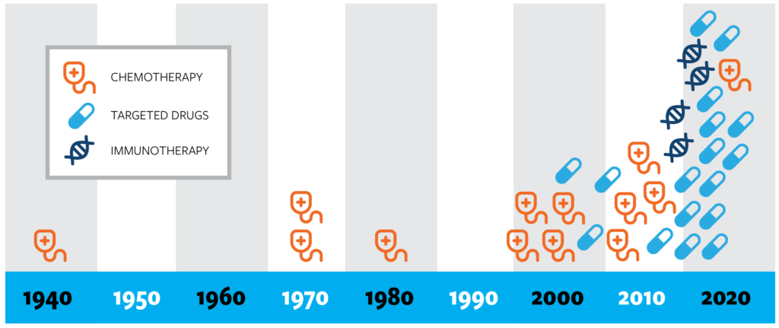
A surge of treatment options…
FDA approved drugs for lung cancer

Slide 4
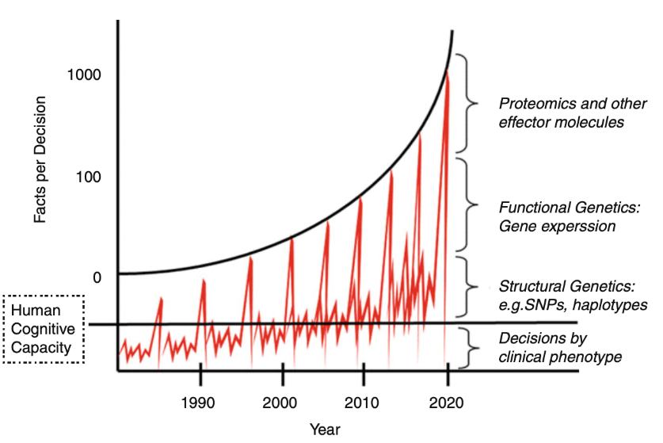
…and of data in need of storage, treatment and analysis

Slide 5
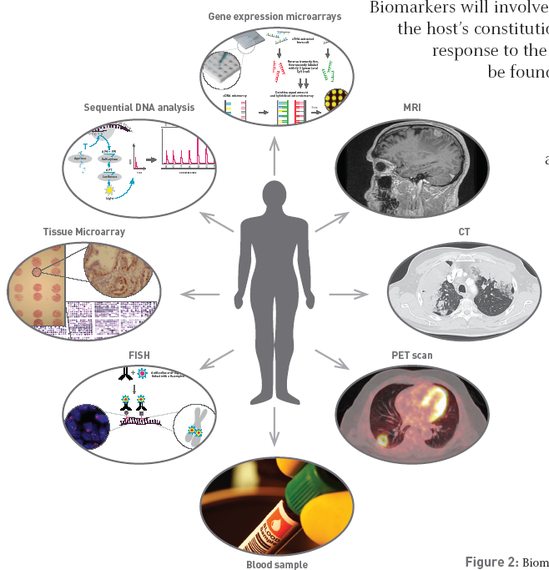



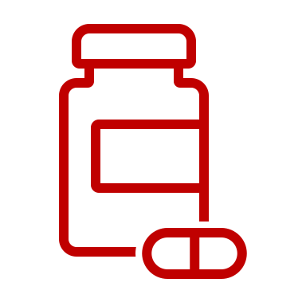


Multimodal patient stratification and monitoring
is key to precision medicine
Predictive medicine for effective customized treatment and treatment monitoring

Slide 6


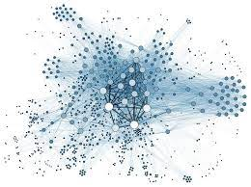
Multimodal patient stratification and monitoring
Knowledge base for PM research and development
Multi-modal patient profiling
precision medicine knowledge base
Outcome data
Healthcare data

Slide 7
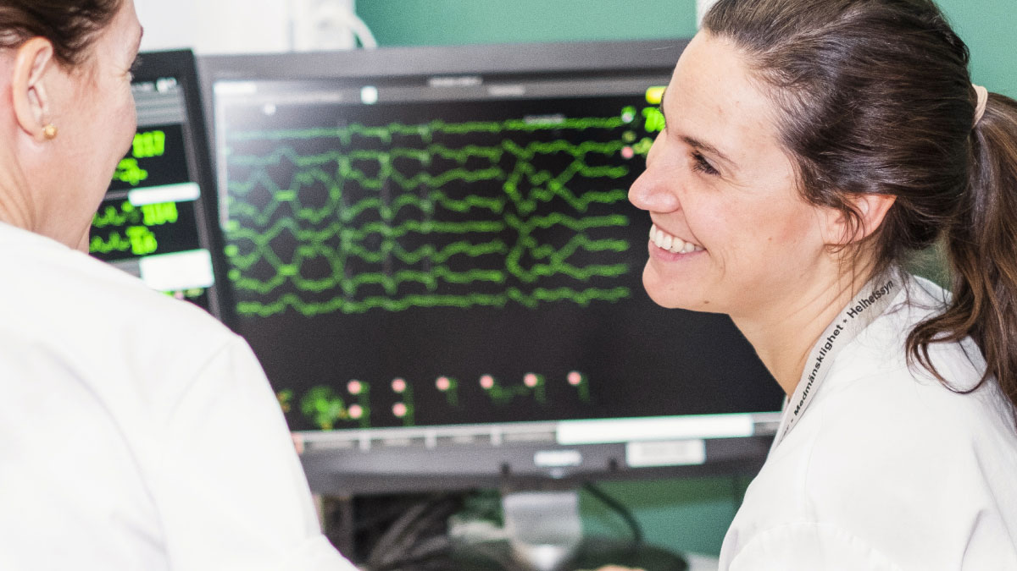
A paradigm shift in health care
The body of knowledge is increasing exponentially
Rapid development in advanced technology and diagnostic tools
New biomarkers explored and available
Increasing amount of complex data per patient
More and more advanced treatments that use biomarkers
New opportunities require new conditions
      The right treatment at the right time for every individual patient

Slide 8




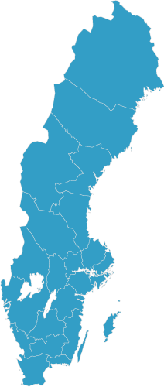
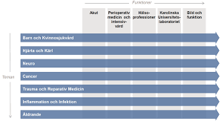
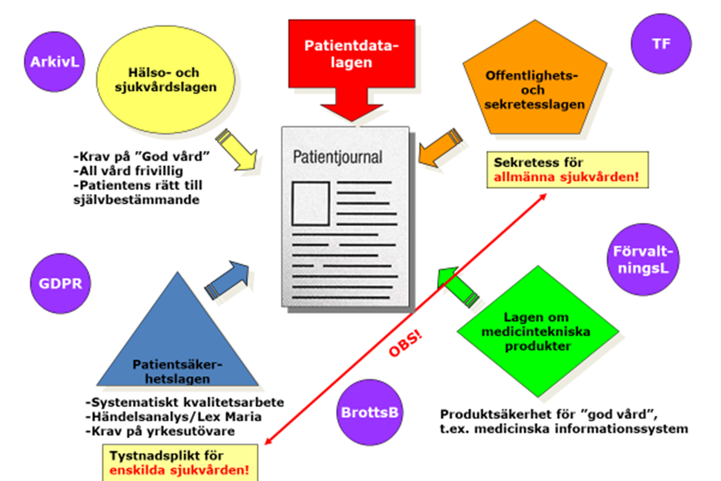
Precision medicine presents many challenges
Separate organizations for health care (regional) and research and education (state)
Health care run by 21 regions
New reimbursement schemes
Secure storage and management of large scale data
New competencies and ways of working within health care
Legal and regulatory challenges

Slide 9
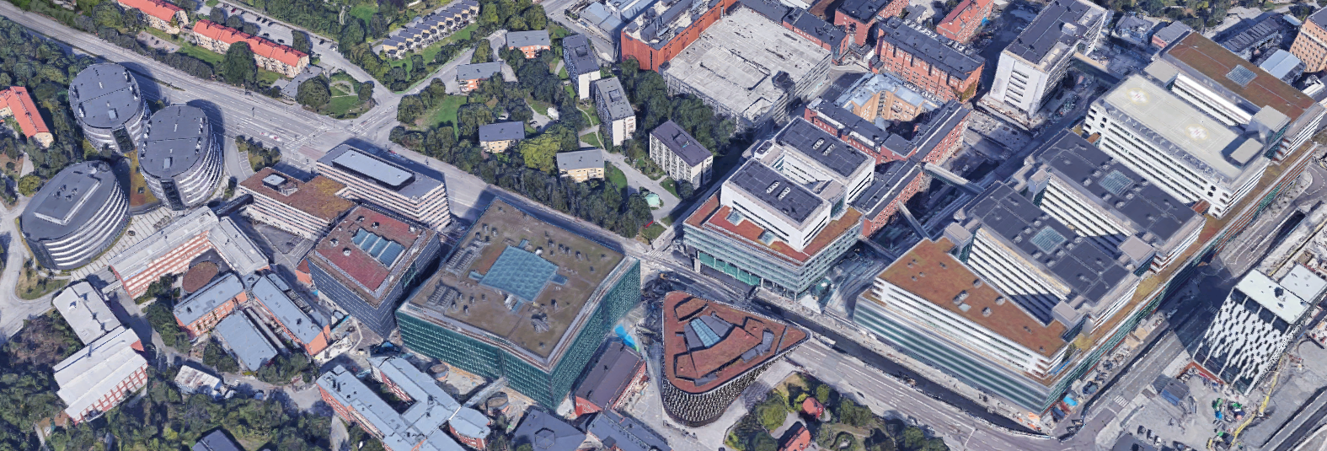

Precision Medicine Centre Karolinska
A unique collaboration
New seamless organization
Cross collaboration between
disciplines, academy and health care
Sharing knowledge and
infrastructure
Geographic proximity

Slide 10
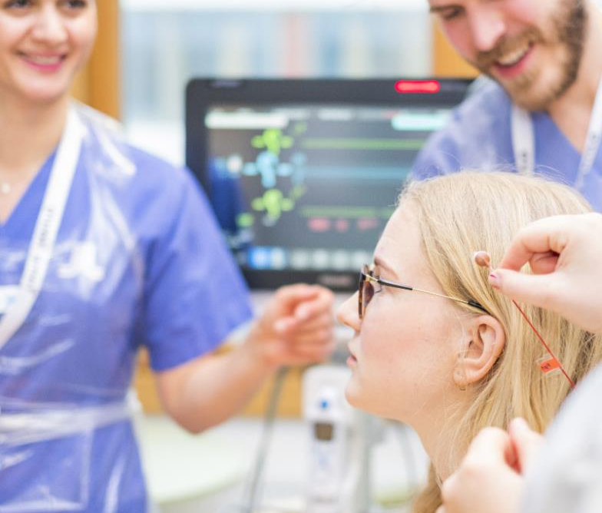
Precision Medicine Centre Karolinska
Examples of focus areas
Academy integrated in health care
Data handling
  Storage and computation capacity
  Bioinformatics (new competences)
  AI will be instrumental
Diagnostic development
  Testbeds
  Integrated research platforms
  Structures for implementation of research and innovation
Clinical trial unit as an integrated part
of the patient’s treatment

Slide 11
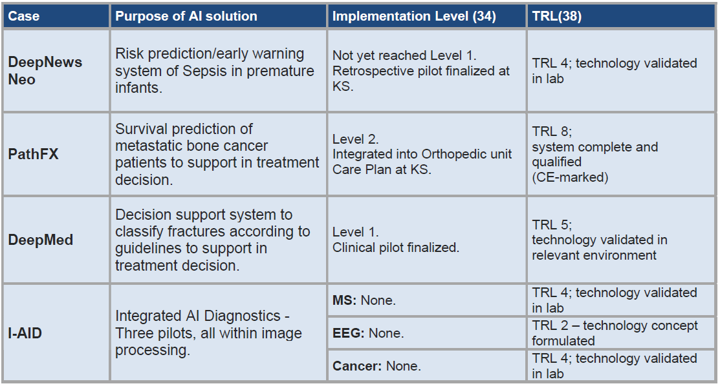
Examples of AI applications
Source: From pilot to clinical practice: Barriers and facilitators in the implementation of artificial intelligence in health care, S. Lerenius, 2021

Slide 12
Decision support based on multimodal diagnostics
The future of AI in PM?

Slide 13
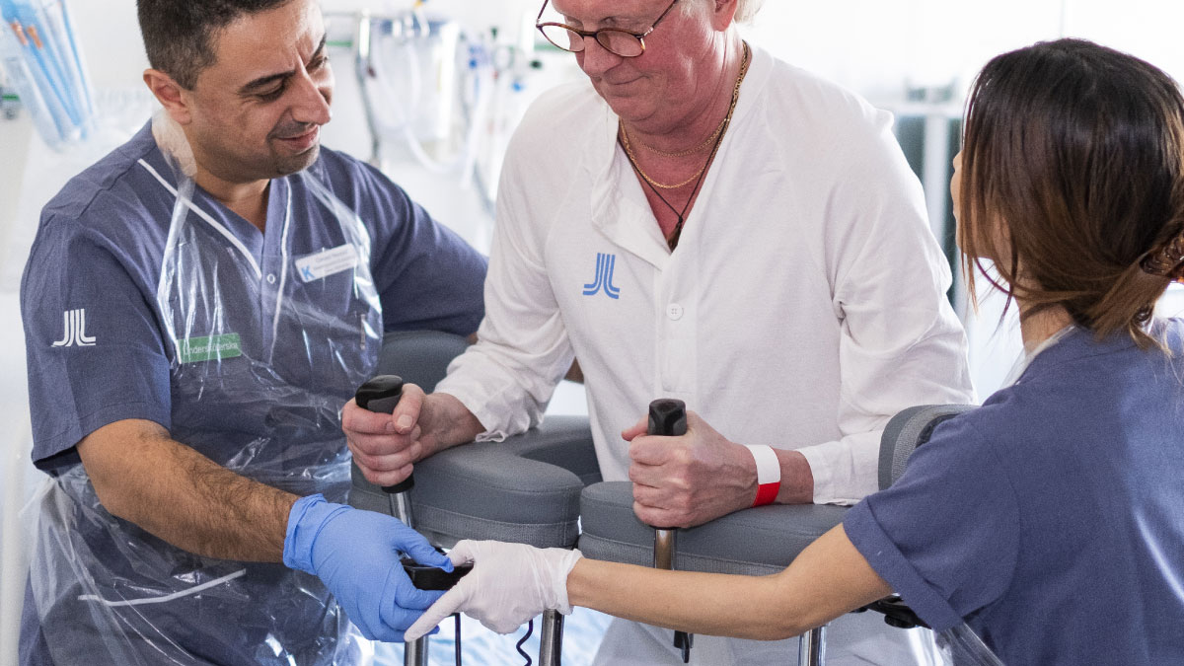
Thank you!
karolinska.se/precisionsmedicin

