Slide 1
Healthcare data in research
Challenges and opportunities
Clara Hellner
Director of Research and Innovation
Region Stockholm

Slide 2
Health care goes digital
Electronical medical records (EMR)
Current and previous symptoms (pain, nausea, shortness of breath, depression..)
Current and previous values (pulse, blood pressure, EKGs…)
Blood samples and other tissue samples
X-rays, CT-scans
Life style data (exposures)
Medications
etc

Slide 3
In combination with
Big data capacity, machine learning, AI…

Slide 4
New horizons in sight!

Slide 5
Challenges
Data are stored in different warehouses in different formats

Slide 6
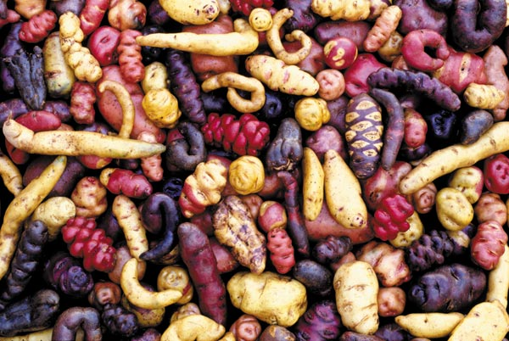
Det här fotot av Okänd författare licensieras enligt CC BY-NC

Slide 7
Challenges
Data are ”owned” by different organisations and locked in behind legal and technical borders
Our lawyers do not agree on what we are allowed to do
Local interpretations
Region Stockholm cannot automatically access data from private caregivers (e.g. 65% of primary care)

Slide 8
Challenges
In reality access is limited
Large resources required to retrieve them

Slide 10
Data presence and quality may vary
Take Care = EMR system in Region Stockholm
Local formats/templates are common
Standardised modules not always used
Free text often preferred over standardised formats
Missing data, unusable data
Our way of clustering data – diagnostic categories - - limits follow-up in other systems
(health care vs the community)

Slide 11
”Is depression becoming more common?”
More people are diagnosed
Are they more depressed or have we changed how we classify their symptoms?
Standardised measures present in a minority of cases

Slide 12
Data from different sources need to be combined
When is Whole Genome Sequencing (WGS) relevant?
Clinically?
For research purposes only?
For clinical research?
How do we combine e.g. genetic data with the clinical perspective, i.e. how do move precision medicine forward?
Clinicians are behind in relation to the technical possibilities

Slide 13
The relevant data may not be collected
We may not know what data is associated with certain outcomes
Or
We may know what data we need but it may not be collected

Slide 14
”When and why will elderly living at home be at higher risk of falling?”
What measures would be indicative of this outcome?
What are relevant outcomes and who decides what is most relevant?
How do we collect them?
Who will do the measuring and documentation?
Self-collected health data still scarce and its association with outcomes need to be established

Slide 15
But = Even within the current boundaries we underuse the possibilities Many good examples, among them Centrum för hälsodata = one point of contact for researchers

Slide 16
Thank you!

